Slide 1
Sales Order Analysis Dashboard

Slide 2
Key Areas to Explore
KPI Requirements:
Total number of Orders for first Quarter of the year 2023
Total Categories as per menu
Total number of Items in all categories
Average Orders Per Month
Average Price Per Item
Charts Requirements:
Total Number of Orders Per month
Total Number of orders as per day name
Peak Hours of the day with respect to orders
Top 5 Selling Items w.r.t orders
Bottom 5 Selling Items w.r.t orders
Top 5 Highest Priced Items and their Orders
Top 5 Lowest Priced Items and their Orders
Correlation between Price of Items and their orders placed.

Slide 3
Total number of Orders for first Quarter of the year 2023
MYSQL Query
Output

Slide 4
Total Categories as per menu
MYSQL Query
Output

Slide 5
Total number of Items in all categories
MYSQL Query
Output

Slide 6
Average Orders Per Month
MYSQL Query
Output

Slide 7
Average Price Per Item
MYSQL Query
Output

Slide 8

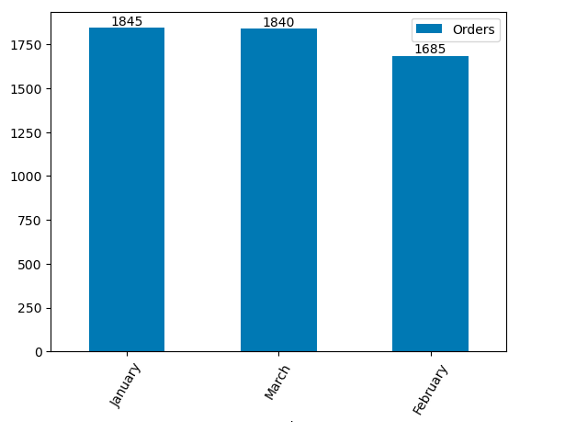
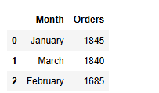
Total Number Of Orders Per Month
MYSQL Query
Output

Slide 9

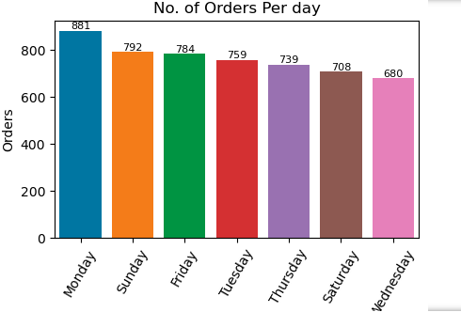
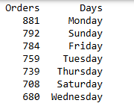
Total Number of orders as per day name
MYSQL Query
Output

Slide 10
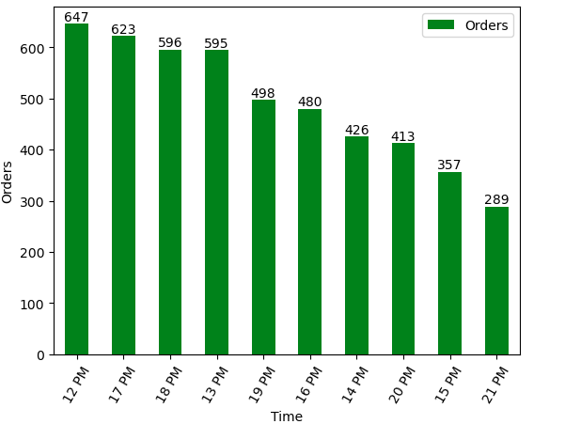
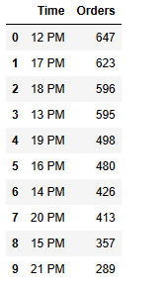
Peak Hours of the day with respect to orders
MYSQL Query
Output

Slide 11
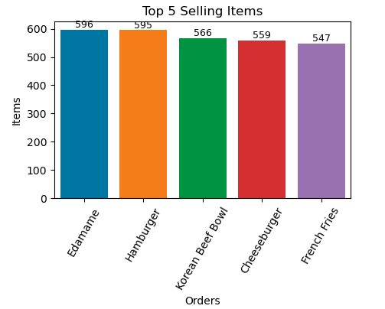
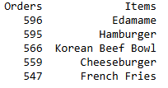
Top 5 Highest Selling Items with respect to Orders
MYSQL Query
Output

Slide 12

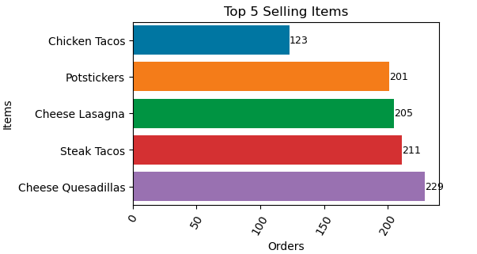
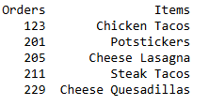
Top 5 Lowest Selling Items with respect to Orders
MYSQL Query
Output

Slide 13
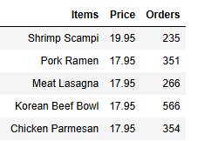
Top 5 Highest Priced Items and their Orders
MYSQL Query
Output

Slide 14
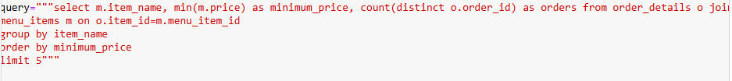
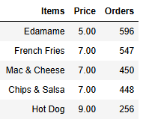
Top 5 Lowest Priced Items and their Orders
MYSQL Query
Output

Slide 15
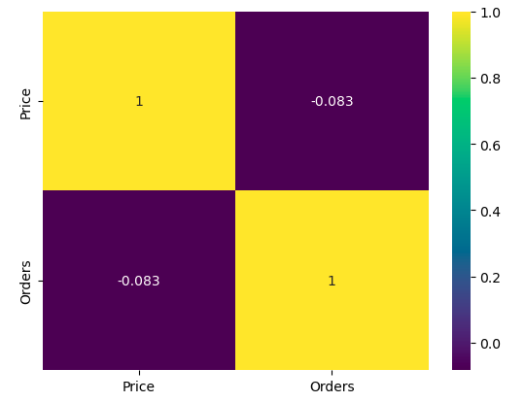
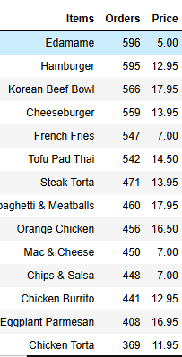
Correlation between Price of Items and their orders placed.
MYSQL Query
Output

Slide 16
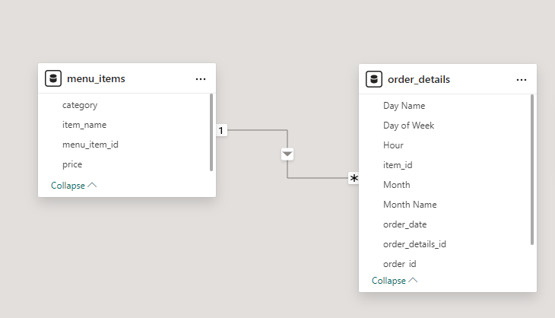
Data Modeling

Slide 17
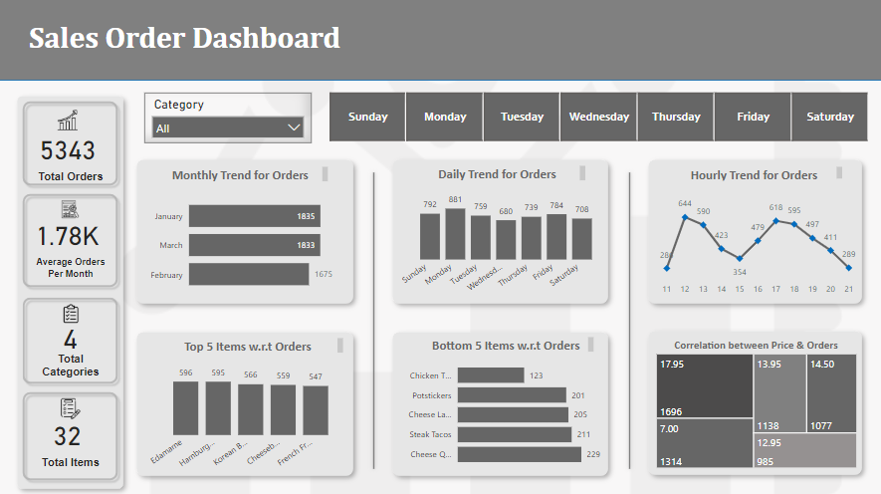
Dashboard of Sales Order Analysis

Slide 18
Key Insights
Total number of Orders Per month shows that January and March are almost receiving same number of orders but there is a drop in orders of February.
Monday is the first working day of week which is generating most of the orders while Friday and Sunday comes next to it.
It is concluded that most of the orders are placed in lunch timings i.e. in between 12 PM to 1 PM noon and then after closure of routine office hours i.e. in between 5 PM to 6 PM.
Top most ordered items include Edamame, Hamburger and Korean Beef Bowl with prices $5, $13 and $18 respectively
Top least ordered item include Chicken Tacos.
Correlation between price and order size is insignificant which is about -0.083. This shows that price is not correlated with the number of orders. The increase or decrease of one element does not affect the rise or fall of other element.

Slide 19
Recommendations
Inventory of highest selling items should be maintained specially during peak hours of the day timings i.e. between 12 PM to 1 PM noon and then then after closure of routine office hours i.e. between 5 PM to 6 PM.
Different discounted deals can be offered having the combination of highest ordered items and least ordered items in order to generate more revenue from least ordered items.
Online Marketing campaigns can boost sales and increase number of orders.
Regularly review performance metrics and adjust strategies as needed for the best outcome.

